Slide 1
Printed Character Recognition Using Neural Networks
Pulin Prabhu (2017130045)
Umang Prajapati (2017130046)
Tania Rajabally (2017130047)
Shruti Rampure (2017130048)

Slide 2
INTRODUCTION
Character Recognition from document images is one of the most widely studied topics in Image Analysis.
These networks can be used for document analysis, document retrieval etc.
5 phases for building the neural network.

Slide 3
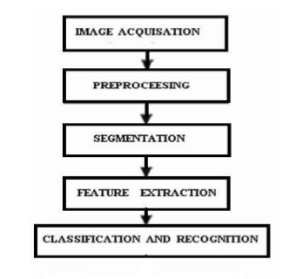
PHASES

Slide 4
PREPROCESSING
Noise Removing.
Binarization.
Rotation removal.
Line thinning.

Slide 5
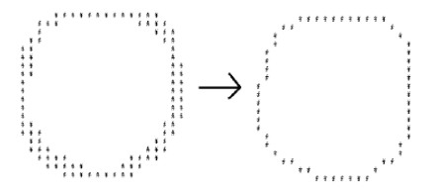
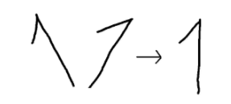
Rotation Removal
Line Thinning

Slide 6
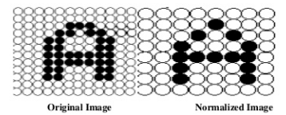
SEGMENTATION
Image is decomposed into sub images.
Labelling process - assigning a number to each character.
Labelling provides information about number of characters in an image.
Each individual character is uniformly resized into pixels.
Then we normalize the size of the characters.

Slide 7
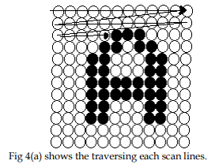
CHARACTER EXTRACTION ALGORITHM
Create a traversal list
Scan each row pixel by pixel
Pixel is black
Yes
Pixel is in traversal list
Yes
No
Edge Detection Algorithm
Add pixels to traversal list

Slide 8
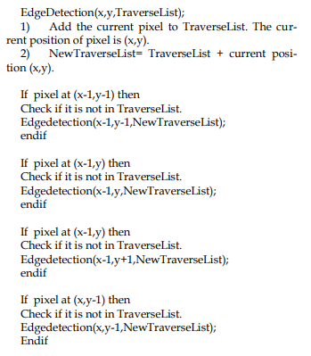
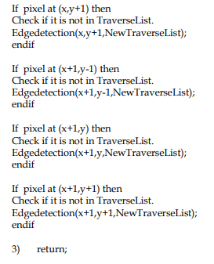
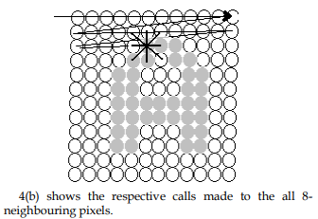
EDGE DETECTION ALGORITHM

Slide 9
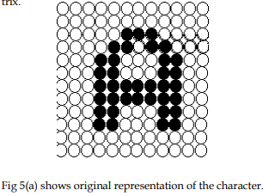
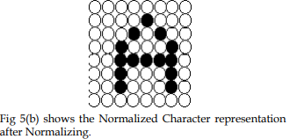
NORMALIZING

Slide 10
FEATURE EXTRACTION
Two main types of feature extraction:
Based on Character Geometry
Uses different line types and positional features
Using Gradient Features
Change in intensity in a small neighbourhood of pixels

Slide 11
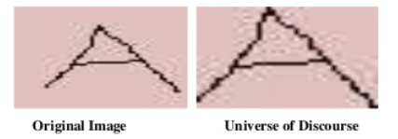

FEATURE EXTRACTION - CHARACTER GEOMETRY
Universe of Discourse
Shortest matrix that fits entire character skeleton
Zoning
Dividing the image in equal sized windows
Applying feature extraction on the windows
Starters
Those pixels with only one neighbour in character skeleton

Slide 12
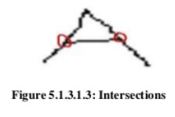
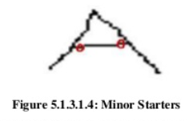
FEATURE EXTRACTION - CHARACTER GEOMETRY
Intersections
Pixels having multiple neighbours
Minor Starters
Pixels neighbouring the intersections

Slide 13

GRADIENT FEATURE EXTRACTION
Measures magnitude and scale of greatest change in intensity in small neighbourhood
Computed by means of Sobel template

Slide 14
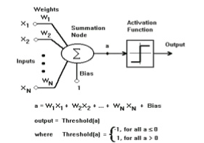
Classification
Why the use of an ANN ?
Animals recognize various objects and make sense out of large amount of visual information, apparently requiring very little effort.
Simulating the task performed by animals to recognize to the extent allowed by physical limitations will be enormously profitable for the system.
This necessitates study and simulation of Artificial Neural Network.

Slide 15
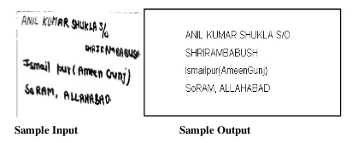
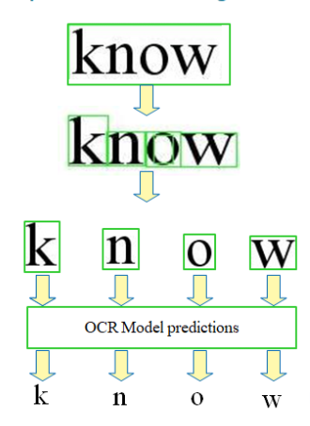
Classification
Typical pattern recognition systems are designed using two pass.
first pass is a feature extractor that finds features within the data which are specific to the task being solved (e.g. finding bars of pixels within an image for character recognition)
The second pass is the classifier. which is more general purpose and can be trained using a neural network and sample data sets.
The feature extractor typically requires the most effort as it is usually hand-crafted based on the application.
The classification is done on the basis of Input vectors and the corresponding target vectors are used to train a network until it can approximate a function.

Slide 16
THANK YOU!!

